Slide 1
ROLES OF COMPUTER IN MANUFACTURING
BY
GROUP 11
lecturer in charge: Dr anireh

Slide 2
INTRODUCTION
Computer has transformed manufacturing by enhancing efficiency, precision, and automation. From Computer-Aided Manufacturing(CAM) to AI-driven production, they reduce human error and optimize processes.
Initially used for calculations and basic control systems, improving accuracy in production, computers started controlling machines, enabling automation, precision cutting and faster production. CAD(Computer-Aided Design) improved product modelling e.g 2D and 3D printing, while CAM enhanced machine operations. This presentation explores the roles and limitations in the manufacturing industry.

Slide 3
ANCIENT VS MODERN
In Ancient Times, manufacturing depended on manual labor, handmade tools, and simple techniques. Production was slow, inconsistent, and limited in scale, with high chances of errors.
But, in modern times, manufacturing is now driven by automation, CAD/CAM software, and robotics, ensuring high precision, faster production, and improved quality. Internet of Things(IoT) enables real-time monitoring, while AI enhances decision-making, making factories more efficient and adaptive.

Slide 4
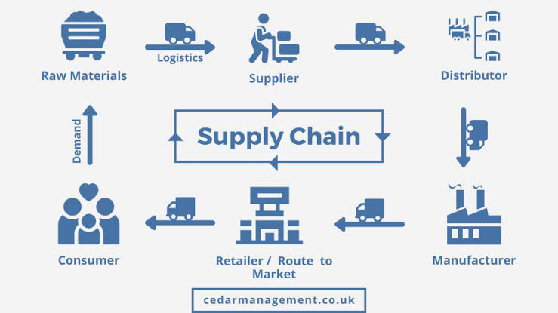
ROLES OF COMPUTER IN MANUFACTURING
Supply Chain Management(SCM):
This approach uses technologies such as artificial intelligence (AI), machine learning (ML), Internet of Things(IoT) and advanced analytics to enhance various aspects of supply chain management, including demand forecasting, inventory management and logistics.

Slide 5
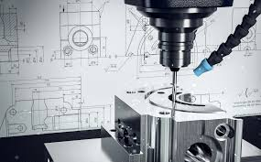
2. Design and Prototype:
With digital prototyping, engineers test and modify design in a virtual environment, allowing for quicker iterations and more informed decision making. This process also facilitates better collaboration across teams and helps align the product design with manufacturing capabilities.

Slide 6
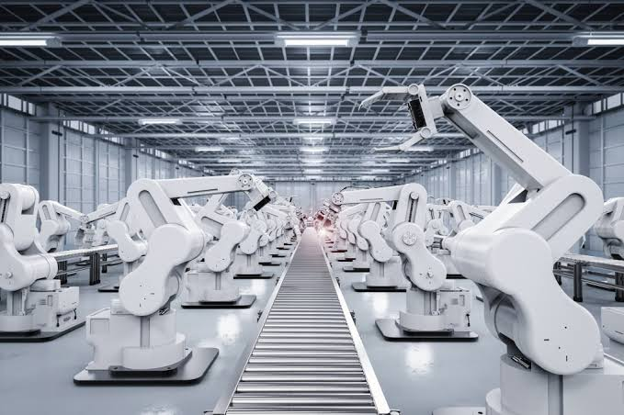
.
3. Computer Manufacturing Automation:
Provide instruction in computer architecture, interfacing to mechanical systems, and software development for continuous control and discrete event systems. This is accomplished by presenting theoretical material and hands-on laboratory experiment.

Slide 7
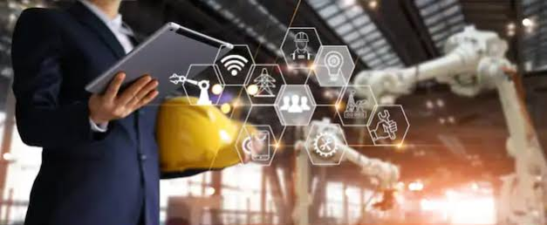
.
4. Production Planning and Control:
Production planning and control manages and schedules the allocation of human resources, raw materials, work centers, machinery, and production processes. It finds the most efficient way to produce finished goods with lead times needed to meet production demand.

Slide 8
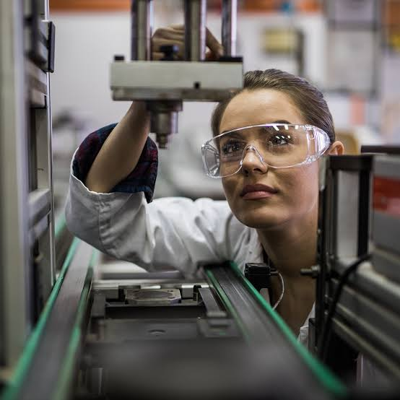
.
5. Quality Control and Inspection:
Quality inspection is a key component of quality control in industrial manufacturing. It involves examining , testing, gauging, or measuring different features of an industrial product and comparing those results with specified benchmarks to determine if there is conformity.

Slide 9
LIMITATIONS
1. Cyber Security Risks:
Data breaches and cyber-attacks can disrupt production and leak sensitive company information and so strong cyber security measures and regular software updates are required.
2. High Maintenance and Upkeep cost:
Regular software updates, hardware replacements, and servicing add to operational costs, unexpected repairs can lead to budget overruns.
3. Need For Skilled Workforce:
Lack of skilled labor can slow down production and efficiency, regular upskilling is necessary to keep up with technological advancements.

Slide 10
CONCLUSION
The use of computers in manufacturing has revolutionized industries, making them more efficient and competitive. However, challenges like costs, cyber security and workforce adaptation must be addressed for successful implementation. As technology advances, smart factories and AI-driven manufacturing will shape the future of industrial production.

Slide 11
CLOSING
THANK
YOU

